Slide 1
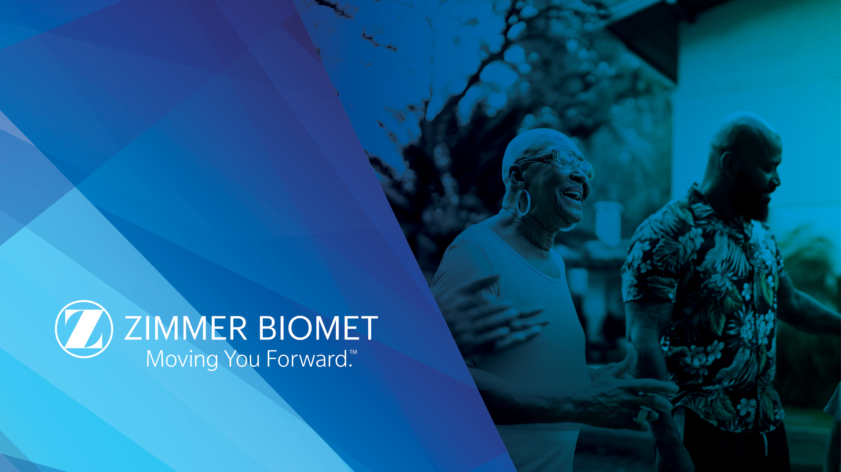
SCADA IT/OT Transformation
3-Year Plan
AS OF 2026-04-30

Slide 2
Executive Summary
Vision: stable, single point of integration between shopfloor OT and enterprise IT.
Pillar 1 — Unification: 100% of sites on the standardized stack at end of Year 3.
Pillar 2 — Analytics/AI enablement: ≤15-minute analytics SLO; one "not possible before" use case in production.
Pillar 3 — Legacy retirement: bespoke IT↔OT integration inventory driven to zero.
Out of scope: operator UX modernization, licensing strategy, VM-level DR, physical network segmentation.
CONFIDENTIAL – FOR ZIMMER BIOMET INTERNAL USE ONLY
2

Slide 3
Today's Reality
Split SCADA stack — Aveva System Platform for validated data; Ignition for KPI monitoring.
Central Ignition in South Bend holds direct OPC UA sessions to site equipment over the WAN.
Multiple concurrent OPC UA sessions to the same equipment from different consumers.
Three legacy IT↔OT integrations bypass ScadaBridge central (Delmia DNC, Camstar MES, custom email service).
Fragmented data access — consumers reading the same tag can see different values depending on sampling/deadband settings.
CONFIDENTIAL – FOR ZIMMER BIOMET INTERNAL USE ONLY
3
Full detail: current-state.md → Systems & Interfaces, Equipment OPC UA.

Slide 4
Vision
A stable, single point of integration between shopfloor OT and enterprise IT.
Every cross-domain path flows through ScadaBridge central — the sole sanctioned IT↔OT crossing point.
Equipment data is site-local, canonically modeled, and shared through a single session per device.
Tiebreaker for ambiguous decisions: preserve this stable-single-point-of-integration posture.
CONFIDENTIAL – FOR ZIMMER BIOMET INTERNAL USE ONLY
4

Slide 5
Three Pillars
PILLAR 1
PILLAR 2
PILLAR 3
Unification
Analytics / AI Enablement
Legacy Retirement
100% of sites on the standardized stack.
≤15-minute SLO; one "not possible before" use case in production.
Inventory driven to zero.
Three bespoke IT↔OT integrations today; each migrates to ScadaBridge-central or is decommissioned.
Every site runs OtOpcUa + ScadaBridge + Redpanda + SnowBridge + Snowflake. No bespoke site-specific integration.
Canonical model + curated layer unlock cross-domain analytics that fragmented today's estate can't deliver.
CONFIDENTIAL – FOR ZIMMER BIOMET INTERNAL USE ONLY
5

Slide 6
Enterprise Layout
PRIMARY DATA CENTER
South Bend — central hosting for Aveva System Platform primary cluster, Ignition, Historian, Snowflake.
LARGEST SITES
Warsaw West (bldg-5, bldg-19) · Warsaw North — one cluster per production building.
OTHER INTEGRATED SITES
Shannon · Galway · TMT · Ponce — single cluster per site.
NOT YET INTEGRATED
Berlin · Winterthur · Jacksonville · others — lighter-weight onboarding pattern Year 2+.
CONFIDENTIAL – FOR ZIMMER BIOMET INTERNAL USE ONLY
6
Smaller-site list is volatile; rely on named examples as illustrative, not authoritative.

Slide 7
Today's Systems
Aveva System Platform — validated data collection; primary cluster central + site clusters.
Ignition SCADA — KPI monitoring; central in South Bend, WAN-dependent direct OPC UA to sites.
ScadaBridge — in-house Akka.NET integration layer; already deployed; the IT↔OT strategic layer.
LmxOpcUa — in-house OPC UA server exposing System Platform objects; per-node today, evolves into OtOpcUa.
Camstar MES — sole enterprise MES; today integrates via single Aveva Web API call.
Aveva Historian — sole historian; central-only in South Bend; permanent retention; BOBJ → Power BI migration in flight.
CONFIDENTIAL – FOR ZIMMER BIOMET INTERNAL USE ONLY
7

Slide 8
Goal State — Layered Architecture
LAYER 1 — EQUIPMENT
PLCs, CNCs, OPC UA-native devices
One OPC UA session per device; OtOpcUa holds it.
LAYER 2 — OtOpcUa
Equipment namespace + System Platform namespace (absorbs LmxOpcUa)
Clustered, site-local. Single sanctioned OPC UA access point per site.
LAYER 3 — SCADA
Aveva System Platform (validated) · Ignition (KPI)
Derives canonical machine state from raw signals.
LAYER 4 — ScadaBridge
IT/OT bridge — central integration layer
Deadband, store-and-forward, producer to Redpanda.
ScadaBridge central is the sole IT↔OT crossing point.
CONFIDENTIAL – FOR ZIMMER BIOMET INTERNAL USE ONLY
8

Slide 9
End-to-End Data Flow
Equipment
→
OtOpcUa
→
System Platform / Ignition
→
ScadaBridge
OT
OT · Layer 2
OT · Layer 3
OT · Layer 4
Redpanda
→
SnowBridge
→
Snowflake
→
Power BI
IT · EventHub
IT · Ingest + Transform
IT · Curated Layer
IT · Consumer
A tag read from a machine in Warsaw West flows across the stack into enterprise analytics, without a second IT↔OT crossing.
CONFIDENTIAL – FOR ZIMMER BIOMET INTERNAL USE ONLY
9

Slide 10
OtOpcUa — the Unification Layer
Single sanctioned OPC UA access point per site — one session per piece of equipment.
Two namespaces: equipment (raw) + System Platform (processed) — absorbs LmxOpcUa.
Clustered, co-located on existing System Platform nodes — no new hardware footprint.
Hybrid driver strategy: proactive core library (8 drivers) + on-demand long-tail.
OPC UA-native auth: UserName tokens + standard security modes (inherited from LmxOpcUa).
Data-path ACL model: scope hierarchy + per-node permissions, committed in v2.
Tiered cutover: ScadaBridge first, Ignition second, System Platform IO last (across Years 1–3).
CONFIDENTIAL – FOR ZIMMER BIOMET INTERNAL USE ONLY
10

Slide 11
Analytics Stack — SnowBridge + Snowflake
SnowBridge owns the full path: ingest + in-process transform + curated-table write.
Custom-built .NET service that reads from Aveva Historian SQL (Year 1) and Redpanda/ScadaBridge (Year 2).
In-process transforms, canonical-model-aligned — aggregation, state enrichment, dim_equipment resolution.
No dbt, no external orchestrator, no Snowflake landing tier — transforms live in the service.
Governed selection of topics/tags via operator web UI with blast-radius-based approval workflow.
≤15-minute analytics SLO end-to-end (ScadaBridge emit → curated table in Snowflake).
One "not possible before" AI/analytics use case in production by end of plan — pillar 2 gate.
CONFIDENTIAL – FOR ZIMMER BIOMET INTERNAL USE ONLY
11

Slide 12
Redpanda EventHub — the Async Backbone
Self-hosted Kafka-compatible backbone. Single-cluster HA, central in South Bend.
Per-topic tiered retention — operational 7d · analytics 30d · compliance 90d.
Bundled Schema Registry, Protobuf schemas in central schemas repo with buf CI.
BACKWARD_TRANSITIVE compatibility — consumers can upgrade independently of producers.
Topic naming: {domain}.{entity}.{event-type}; site identity lives in the message, not the topic.
Auth: SASL/OAUTHBEARER via enterprise IdP + prefix ACLs per producer/consumer principal.
Store-and-forward at ScadaBridge handles WAN outages; analytics-tier retention doubles as a replay surface.
CONFIDENTIAL – FOR ZIMMER BIOMET INTERNAL USE ONLY
12

Slide 13
3-Year Roadmap — Workstreams × Years
Six workstreams across three years. Each cell shows the single most load-bearing commitment.
Workstream | Year 1 — Foundation | Year 2 — Scale | Year 3 — Completion
OtOpcUa | Evolve LmxOpcUa; deploy to every site; tier-1 cutover begins; UNS hierarchy walk | Complete tier 1; begin tier 2 (Ignition); long-tail drivers on demand | Complete tier 2; execute tier 3 (System Platform IO) with compliance validation
Redpanda EventHub | Central cluster in SB; schema registry; canonical model v1 published (FANUC CNC pilot) | Expand topic coverage; WAN-outage replay drill; iterate canonical model | Steady state; canonical model mature; alerting + runbooks hardened
SnowBridge | Custom build in .NET; first adapter (Historian SQL); first curated tables aligned to canonical model | Add Redpanda adapter; operator UI + approval workflow; canonical-state OEE model; first "not possible before" use case in dev | All source adapters live; hardening. "Not possible before" use case in production — pillar 2 passes
ScadaBridge Extensions | Deadband / exception-based publishing; EventHub producer with store-and-forward | Roll to all integrated sites; tune deadband from observed Snowflake cost | Steady state; residual cleanup for onboarding / retirement tails
Site Onboarding | No new sites; define lightweight onboarding pattern for smaller sites | Pilot one smaller site; scale to additional smaller sites | Complete onboarding of all remaining smaller sites — pillar 1 passes
Legacy Retirement | Inventory populated (3 rows); retire first integration as pattern-proving exercise | Bulk migration against inventory; quarterly burn-down tracking | Inventory reaches zero — pillar 3 passes
CONFIDENTIAL – FOR ZIMMER BIOMET INTERNAL USE ONLY
13

Slide 14
Year 1 Focus
OtOpcUa — evolve LmxOpcUa, deploy to every site, begin ScadaBridge-first cutover, UNS hierarchy walk.
Redpanda — stand up central cluster, schema registry, initial topics, publish canonical model v1.
SnowBridge — design + build; first source adapter (Historian SQL); first curated tables aligned to canonical model.
ScadaBridge Extensions — deadband / exception-based publishing + EventHub producer with store-and-forward.
Site Onboarding — no new sites; define the lightweight onboarding pattern for smaller sites.
Legacy Retirement — inventory populated (3 rows); retire first integration as pattern-proving exercise.
CONFIDENTIAL – FOR ZIMMER BIOMET INTERNAL USE ONLY
14

Slide 15
Pillar 3 — Legacy Retirement (3 → 0)
LEG-001
Aveva Web API → Delmia DNC
Bidirectional orchestrated handshake. Harder retirement — requires ScadaBridge scripts to re-implement System Platform parse logic.
LEG-002
Aveva Web API ← Camstar MES
Camstar-initiated. Easier retirement — ScadaBridge already has a native Camstar path; requires Camstar-side reconfiguration.
LEG-003
System Platform → custom email notification service
Easier retirement — ScadaBridge native notifications already exist.
Carve-out: Historian MSSQL reporting surface (BOBJ / Power BI) is explicitly not legacy — see legacy-integrations.md → Deliberately not tracked.
CONFIDENTIAL – FOR ZIMMER BIOMET INTERNAL USE ONLY
15

Slide 16
Digital Twin Scope
Scope is two access-control patterns — not a new component, not a new workstream. Both are delivered by architecture already committed (OtOpcUa ACL model + canonical model + single-connection-per-equipment).
PATTERN 1
PATTERN 2
Environment-lifecycle promotion
Safe read-only consumption
Promote between dev / staging / prod by flipping write-authority ACLs against stable equipment UUIDs — no client reconfiguration.
KPI / monitoring consumers get read-only grants with a structural zero-write-path guarantee — no equipment-side session for them to misuse.
Out of scope for this plan: physics simulation, FAT, commissioning emulation. Those would be separate funded initiatives — adjacent to the plan, not part of it.
CONFIDENTIAL – FOR ZIMMER BIOMET INTERNAL USE ONLY
16

